Slide 1
<Country Name>
Analysis of National Learning Assessment Systems [ANLAS]
<Dissemination activity>
<Presenter(s)>
<Date>
Notes:
[You may add your organization name and/or logo to this first page.]

Slide 2
Presentation outline
Introduction
ANLAS in <country name>
Key findings of ANLAS
Using the ANLAS findings
Questions & discussion

Slide 3
Introduction

Slide 4
What is ANLAS?
The Analysis of National Learning Assessment Systems (ANLAS) is a resource provided by the Global Partnership for Education (GPE) through its Assessment for Learning (A4L) initiative.
ANLAS allows to systematically gather and analyze information about the national learning assessment system, with the aim to inform the development and implementation of improvement strategies as part of the wider education sector planning process.
ANLAS manual, chapter 1 (ACER 2019)
Notes:
[See chapter 1 of the ANLAS manual for more information.]

Slide 5
What are the main features of ANLAS?
The comprehensive, qualitative analysis focuses on three dimensions:
Context of the assessment system
Quality of assessment programs
Coherence of the assessment system
The application of knowledge and demonstration of 21st century skills is relevant to all three dimensions.
ANLAS manual, chapter 3 (ACER 2019)
Notes:
[See chapter 1 of the ANLAS manual for more information.]

Slide 6
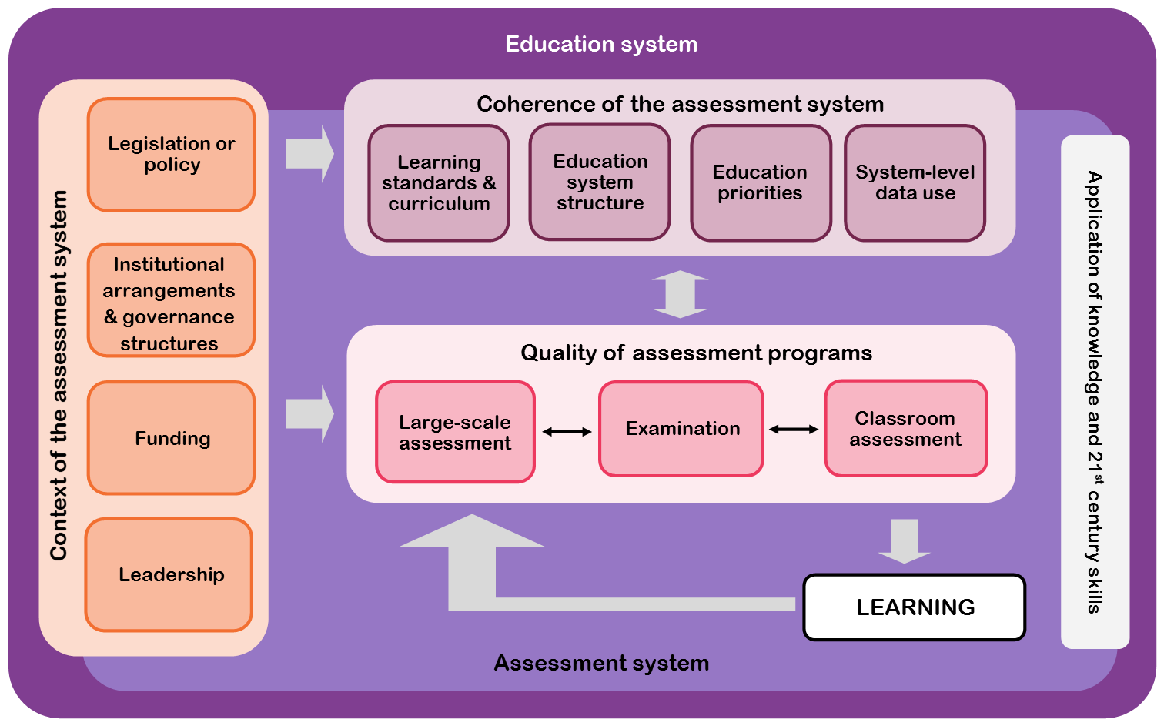
The ANLAS model
© ACER 2019
Notes:
This focus of the analysis is illustrated in the ANLAS model, which provides the framework for the qualitative analysis of national learning assessment systems (ACER 2019).
The three dimensions – context of the assessment system, quality of assessment programs and coherence of the assessment system – and the cross-dimensional element of application of knowledge and 21st century skills are integrated to favor the use of assessment data in education policy and practice, with the ultimate aim to improve learning.
The dimension Context of the assessment system covers four key areas: [read key areas from slide].
The dimension Quality of assessment programs covers important quality aspects of large-scale assessment and examinations, and classroom assessment.
The third dimension Coherence of the assessment system covers four key areas that relate to the extent to which the assessment system is consistent with important aspects of the broader education system and within the assessment system: [read key areas from slide]
The application of knowledge and 21st century skills is an important cross-dimensional element of ANLAS.

Slide 7
What are 21st century skills?
Skills that build the foundation for successful participation in knowledge-based society and life in general (GPE 2018; Care & Luo 2016)
Also known as general capabilities, transversal competencies or cross-curricular competencies (Scoular & Care 2017)
Examples: problem solving, critical thinking, creativity, communication, collaboration, and social-emotional skills (e.g., intrapersonal, interpersonal, empathy).
ANLAS manual, section 3.4 (ACER 2019)
Notes:
An important element of ANLAS that is relevant to all three dimensions is the application of knowledge and 21st century skills.
It is an increasing priority for countries around the world to assess the skills that contribute to the holistic development of learners and that build the foundation for successful participation in life-long learning, occupational careers, society and life in general (GPE 2018).
A focus has been on skills that are considered particularly important to succeed in today’s knowledge-based society in which innovation and technology are predominant. These skills are often referred to as 21st century skills (Care & Luo 2016).
Other terminology commonly used to describe this set of skills includes general capabilities, transversal competencies or cross-curricular competencies.
Prominent examples of such skills are problem solving, critical thinking, creativity, communication, collaboration, and social-emotional skills (for example, intrapersonal, interpersonal, empathy) (Scoular & Care 2017).

Slide 8
Demonstration of knowledge and 21st century skills
ANLAS allows to examine:
the extent to which learning assessment focuses on the application of knowledge and demonstration of skills, and
the extent to which 21st century skills are an integral part of the assessment system.
ANLAS manual, section 3.4 (ACER 2019)
Notes:
Assessing the application of knowledge and skills with ANLAS contrasts to approaches that solely focus on the demonstration of factual knowledge and routine procedures (Turner 2014).
ANLAS allows to examine the extent to which learning assessment focuses on the application of knowledge and demonstration of skills, and
the extent to which 21st century skills are an integral part of their assessment system.

Slide 9
How is ANLAS implemented?
A country-led, participative process, implemented by a national team and guided by a steering committee
Main methods are document review and consultations with key stakeholders in the education system and in the assessment system
Key stakeholders collaboratively analyze the learning assessment system, identify where improvements are required, and make recommendations.
ANLAS manual (ACER 2019)
Notes:
ANLAS is conceptualized as a country-led, participative process that is implemented by a national team, led by a team leader, and guided by a steering committee.
The two main methods for completing the qualitative analysis in ANLAS are document review and consultations with key stakeholders in the education system and in the assessment system.
The participative analysis process enables key stakeholders to collaboratively analyze the learning assessment system, identify where improvements are required and make recommendations on how to strengthen the assessment system.

Slide 10
ANLAS manual and tools
The implementation of ANLAS is guided by the ANLAS manual and a set of tools (in Microsoft Word and Microsoft Excel).
The tools can be adapted to best fit the national context. This contextualization ensures that the identified areas and concrete recommendations for improvement are relevant and appropriate.
The ANLAS manual and tools are available on the GPE website: https://www.globalpartnership.org/
Notes:
The ANLAS manual and a set of tools (in the form of Microsoft Word (2013) and Microsoft Excel (2013) templates) are provided to support the implementation process and to guide the analysis.
Countries can adapt the tools to best fit the national context. This contextualization ensures that the identified areas and concrete recommendations for improvement are relevant and appropriate.
The ANLAS manual and tools are available on the GPE website.

Slide 11
ANLAS in <country name>

Slide 12
Purpose of ANLAS in <country name>
Notes:
[Briefly describe the purpose for undertaking ANLAS in the country based on the key findings document or section 2.1 of the ANLAS report.]

Slide 13
ANLAS implementation overview
Notes:
[Provide a very brief summary of the most important aspects of the ANLAS implementation in the country based on the key findings document or section 2.2 of the ANLAS report. For example, use Exhibit 2 in the ANLAS report to illustrate the implementation process and timeline. Add additional slides as needed.]

Slide 14
ANLAS National Team
Notes:
[Introduce the ANLAS national team based on Exhibit 6 in Appendix 2 of the ANLAS report. For example, copy the parts of the table you want to show, such as name, organization, role in ANLAS and stakeholder group.]

Slide 15
ANLAS Steering committee
Notes:
[Introduce the ANLAS steering committee based on Exhibit 7 in Appendix 2 of the ANLAS report. For example, copy the parts of the table you want to show, such as name, organization and stakeholder group.]

Slide 16
Assessment programs included
Notes:
[Provide a brief description of the assessment programs included in the analysis based on section 2.1 in the ANLAS report.]

Slide 17
Organization of the analysis: Document review
Notes:
[Provide an overview of how the analysis was organized in the country based on section 2.2.2 of the ANLAS report. Provide a brief description of:
How the ANLAS dimensions were described, including the number and kinds of documents reviewed. Use Appendix 4 in the ANLAS report (Exhibit 9).
Add additional slides as needed.]

Slide 18
Organization of the analysis: Stakeholder consultations
Notes:
[Provide an overview of how the analysis was organized in the country based on section 2.2.2 of the ANLAS report. Provide a brief description of:
How the stakeholder consultations were conducted, including the number of consultations for each ANLAS dimension, the form of the consultations such as group or individual consultation, the key stakeholder groups consulted for each ANLAS dimension, and how the information was documented. Use Appendix 4 in the ANLAS report (Exhibit 8).
How the information from multiple stakeholder consultations for each dimension was consolidated. Relate to the evaluation categories, the aspects for improvement and the recommendations made. Indicate if an overall consensus was reached.
Add additional slides as needed.]

Slide 19
Limitations
Notes:
[Discuss any limitations that are important to consider for the interpretation of the ANLAS findings based on section 2.3 of the ANLAS report. Add additional slides as needed.]

Slide 20
Key findings of ANLAS

Slide 21
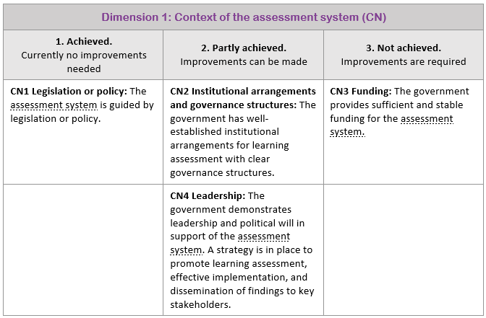
Overview of ANLAS findings
Notes:
[Provide an overview of the ANLAS findings based on the key findings document. Indicate the key areas and the number of key areas that were achieved, partly achieved and not achieved. For example, use screenshots of Synthesis table 1: Overview of ANLAS findings (Exhibit 2 in the key findings document) to present each ANLAS dimension on one slide. An example screenshot is provided for illustration purposes. Remove the example. Add additional slides as needed.]
[For dimension 2A: Discuss the findings for each large-scale assessment and examination included in the analysis, or summarize the findings as well as possible.]
[For dimension 2B: Discuss the findings for each level of school education that was analyzed separately, or summarize the findings as well as possible.]

Slide 22
Overview of ANLAS findings

Slide 23
Overview of ANLAS findings

Slide 24
Overview of ANLAS findings

Slide 25
Dimension 1: Context of the assessment system
Notes:
[For each ANLAS dimension, provide a summary of the main findings presented in the key findings document:
Highlight the main aspects for improvement and recommendations.
Highlight important connections and congruencies, as well as divergences and gaps between the quality objectives and the actual practices.

Slide 26
Dimension 2A: Quality of large-scale assessment and examination
Notes:
[For each ANLAS dimension, provide a summary of the main findings presented in the key findings document:
Highlight the main aspects for improvement and recommendations.
Highlight important connections and congruencies, as well as divergences and gaps between the quality objectives and the actual practices.
For dimension 2A: Discuss the findings for each large-scale assessment and examination included in the analysis, or summarize the findings as well as possible. Highlight any commonalities or discrepancies that may appear across the different programs or levels of school education.]

Slide 27
Dimension 2B: Quality of classroom assessment
Notes:
[For each ANLAS dimension, provide a summary of the main findings presented in the key findings document:
Highlight the main aspects for improvement and recommendations.
Highlight important connections and congruencies, as well as divergences and gaps between the quality objectives and the actual practices.
For dimension 2B: Discuss the findings for each level of school education that was analyzed separately, or summarize the findings as well as possible. Highlight any commonalities or discrepancies that may appear across the different levels of school education.]

Slide 28
Dimension 3: Coherence of the assessment system
Notes:
[For each ANLAS dimension, provide a summary of the main findings presented in the key findings document:
Highlight the main aspects for improvement and recommendations.
Highlight important connections and congruencies, as well as divergences and gaps between the quality objectives and the actual practices.

Slide 29
Using the ANLAS findings

Slide 30
Dissemination strategy
Notes:
[Briefly describe how the findings of ANLAS will be disseminated based on section 4.1 of the ANLAS report. For example, provide a screenshot of the completed ANLAS dissemination strategy. Add additional slides as needed.]

Slide 31
Using ANLAS for education sector planning
Notes:
[Briefly describe how the ANLAS findings will be used based on the key findings document. Focus on how the recommendations will feed into national education sector planning process or other policy processes. Adapt the title as needed.]
[Depending on the dissemination activity, you may wish to provide more detailed information about using the ANLAS findings based on section 4.2 of the ANLAS report. For example, provide a screenshot of Exhibit 4 in the ANLAS report to illustrate how and at which stages the ANLAS findings are likely to be used in the national education sector planning process and/or other relevant policy processes.]
[Add additional slides as needed.]

Slide 32
Using ANLAS for education sector planning
Notes:
[Briefly describe how the ANLAS findings will be used based on the key findings document. Focus on how the recommendations will feed into national education sector planning process or other policy processes. Adapt the title as needed.]
[Depending on the dissemination activity, you may wish to provide more detailed information about using the ANLAS findings based on section 4.2 of the ANLAS report. For example, provide a screenshot of Exhibit 4 in the ANLAS report to illustrate how and at which stages the ANLAS findings are likely to be used in the national education sector planning process and/or other relevant policy processes.]
[Add additional slides as needed.]

Slide 33
Questions and discussion
Notes:
[Facilitate a discussion to support broad application of the ANLAS findings and recommendations. For example, provide some guiding questions for the discussion.]

Slide 34
References
Australian Council for Educational Research. (2019). Analysis of National Learning Assessment Systems (ANLAS): Manual. Washington, DC: Global Partnership for Education.
Care and Luo, "Assessment of Transversal Competencies: Policy and Practice in the Asia-Pacific Region," 2016
Clarke, Marguerite. “What Matters Most for Student Assessment Systems: A Framework Paper: Systems Approach for Better Education Results (SABER) Student Assessment Working Paper No. 1.” Washington, DC: World Bank, 2012.
Global Partnership for Education, 2018
Scoular and Care, "Teaching of Twenty-First Century Skills: Implications at System Levels in Australia " 2017.
Turner, Described Proficiency Scales and Learning Metrics. Assessment Gems No. 4, 2014
Notes:
[References that appear on the introduction slides are provided here. Add any further references that are used in this presentation.]

